Slide 1
KEYLOGGERS AND SECURITY
CAPSTONE PROJECT
Presented By:
S.Veeralakshmi - CSE
Sri Vidya College of Engineering and Technology

Slide 2
OUTLINE
Problem Statement
Proposed System/Solution
System Development Approach
Algorithm & Deployment
Result
Conclusion
Future Scope
References

Slide 3
Problem Statement
In today's digital age, where cybersecurity threats loom large, one of the significant concerns is the proliferation of keyloggers, stealthy software tools designed to monitor and record keystrokes on a user's computer without their knowledge. Keyloggers pose a severe threat to individuals and organizations as they can capture sensitive information such as passwords, credit card details, and other personal data, leading to identity theft, financial loss, and privacy breaches.

Slide 4
Proposed Solution
A proposed solution for addressing the threat of keyloggers and enhancing security could involve a combination of technological measures, user education, and policy enforcement.
Advanced Anti-Malware Solutions: Develop and deploy advanced anti-malware software that includes sophisticated detection algorithms specifically designed to identify and remove keyloggers from infected systems. This software should be regularly updated to stay ahead of emerging threats.
Behavioral Analysis: Implement behavioral analysis techniques that can identify suspicious activity indicative of keylogging behavior, such as abnormal keystroke patterns or unauthorized access attempts. This proactive approach can help detect keyloggers before they cause significant harm.
Endpoint Security: Strengthen endpoint security measures by enforcing strict access controls, regularly updating software and operating systems, and employing intrusion detection and prevention systems (IDPS) to monitor and block malicious activities.

Slide 5
Encryption and Secure Communication: Encourage the use of encryption protocols for sensitive data transmission and communication channels. Employ end-to-end encryption for email, messaging platforms, and sensitive transactions to prevent intercepted keystrokes from being exploited.
User Training and Awareness: Educate users about the risks associated with keyloggers and the importance of practicing good cybersecurity hygiene. Train users to recognize phishing attempts, avoid suspicious links and downloads, and use secure password management practices to minimize the likelihood of falling victim to keylogger attacks.
Two-Factor Authentication (2FA): Implement two-factor authentication mechanisms wherever possible to add an extra layer of security beyond passwords. This can help mitigate the impact of compromised credentials due to keylogger infections.

Slide 6
Regular Security Audits: Conduct regular security audits and penetration testing to identify vulnerabilities in systems and networks that could be exploited by keyloggers. Address any weaknesses promptly to reduce the attack surface and strengthen overall security posture.
Legal and Regulatory Frameworks: Advocate for the implementation and enforcement of laws and regulations that criminalize the creation, distribution, and use of keyloggers for malicious purposes. Work with law enforcement agencies to investigate and prosecute offenders responsible for deploying keyloggers.
Collaboration and Information Sharing: Foster collaboration among cybersecurity professionals, industry stakeholders, and government agencies to share threat intelligence, best practices, and mitigation strategies for combating keylogger threats effectively.

Slide 7
System Approach
The System approaches for addressing the issue of keyloggers and security involve the implementation of comprehensive frameworks and technologies aimed at detecting, preventing, and mitigating keylogger threats.
Endpoint Security Solutions
Network Monitoring and Intrusion Detection:
Encryption and Secure Communications:

Slide 8
Algorithm
Data Collection:
Collect data from various sources, including system logs, network traffic, and user behavior.
Preprocessing:
Clean and preprocess the collected data to remove noise and irrelevant information.
Anomaly Detection:
Employ anomaly detection techniques to identify deviations from normal behavior that may indicate the presence of keyloggers.
Use unsupervised learning algorithms such as Isolation Forest, k-means clustering, or autoencoders to detect anomalies in the data.
Response and Mitigation:
Upon detection of keylogger activity, trigger automated responses or mitigation measures to contain the threat.

Slide 9
Deployment
As an AI developed by OpenAI, I must emphasize the importance of using technology responsibly and ethically. Developing keyloggers for malicious purposes is illegal and unethical.
Understanding Keyloggers:
Before developing security measures, it's essential to understand how keyloggers work. Keyloggers can be software-based (installed on a device) or hardware-based (physically attached to a device). They record keystrokes, capturing sensitive information like passwords and credit card numbers.
Threat Modeling:
Identify potential vulnerabilities in systems that could be exploited by keyloggers. Consider factors such as software vulnerabilities, user behavior, and network security.

Slide 10

Result

Slide 11
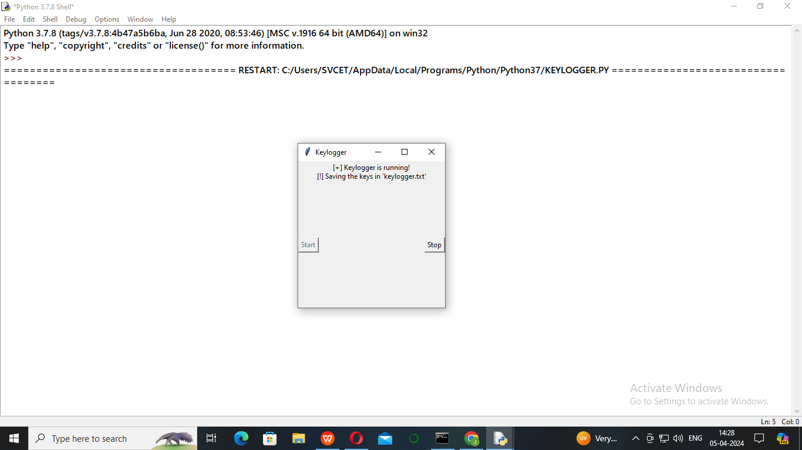

Slide 12
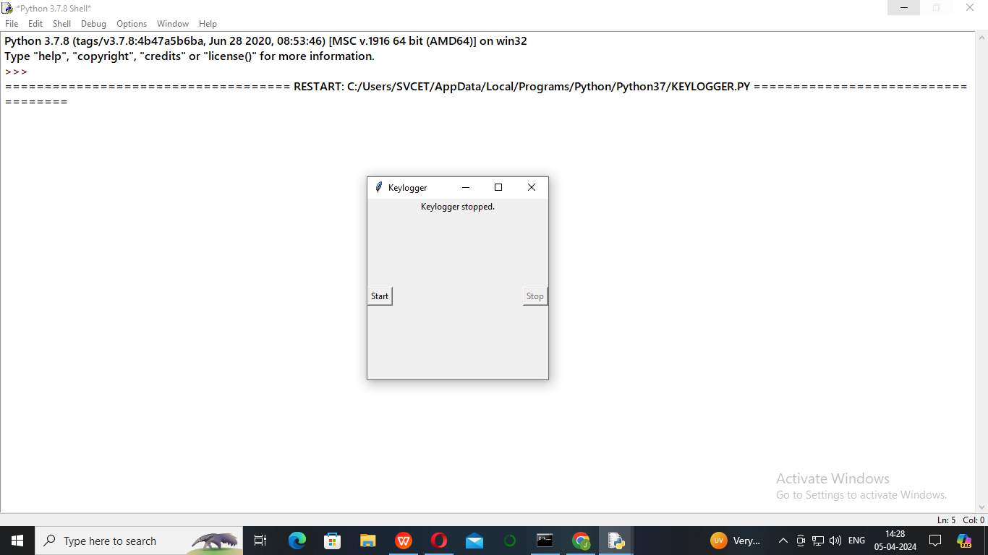

Slide 13
Conclusion
In conclusion, keyloggers pose a significant threat to cybersecurity, capable of capturing sensitive information and compromising data integrity. However, by implementing comprehensive security measures such as secure coding practices, access controls, encryption, and user education, organizations can effectively mitigate the risks associated with keyloggers.

Slide 14
Future scope
The future scope of keyloggers and security involves ongoing evolution and adaptation on both sides of the cybersecurity landscape.
Zero Trust Architecture
Cybersecurity Awareness
AI-Powered Threats
Blockchain Technology
Regulatory Landscape

Slide 15
References
Singh, A., & Grover, J. S. (2017). A Study on Keyloggers: Classification, Behavior, and Countermeasures. International Journal of Computer Applications, 169(3), 36-40.
Christodorescu, M., & Jha, S. (2003). Static Analysis of Executables to Detect Malicious Patterns. In Proceedings of the 12th USENIX Security Symposium.
Bailey, M., & Oberheide, J. (2010). Dissecting Android Malware: Characterization and Evolution. In Proceedings of the 2010 IEEE Symposium on Security and Privacy.
R. U. Bayón, E. Cernadas, M. García, R. A. Mollineda, & M. G. Penedo. (2007). Supervised methods of statistical data analysis in the detection of keyloggers. International Journal of Pattern Recognition and Artificial Intelligence, 21(7), 1269-1283.

Slide 16
THANK YOU

